Slide 1
Global and Transnational Sociology Summer School
June 13 – July 7, 2022

Slide 2
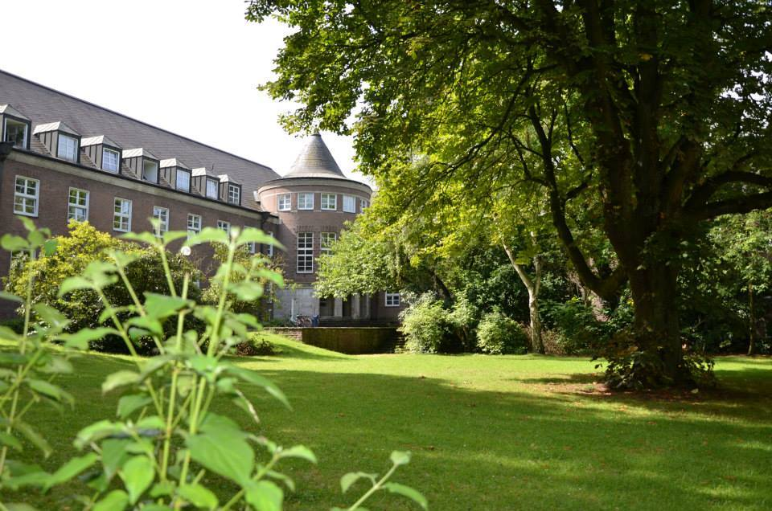
University of Duisburg - Essen
The University of Duisburg-Essen is one of the largest universities in Germany with over 40.000 students enrolled, offering a broad academic spectrum with numerous opportunities to participate in international programs.
The university is BIG, but each seminar will have less than 25 participants, which gives all students the chance to personally engage with world-class academics and instructors.

Slide 3
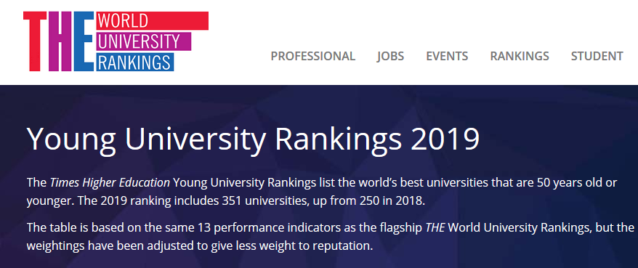

Slide 4
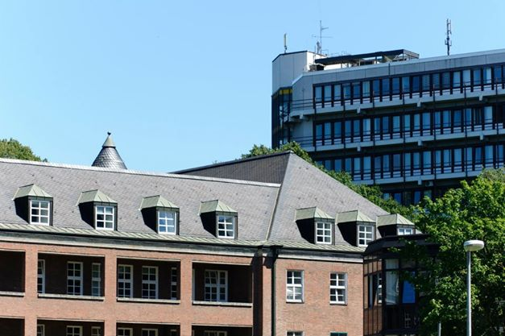
Summer School Building and Surroundings (LF)
The Summer School will take place in Duisburg. The Duisburg Campus is small, tree-covered and has an interesting mix of pre-war and post-war architecture.

Slide 5
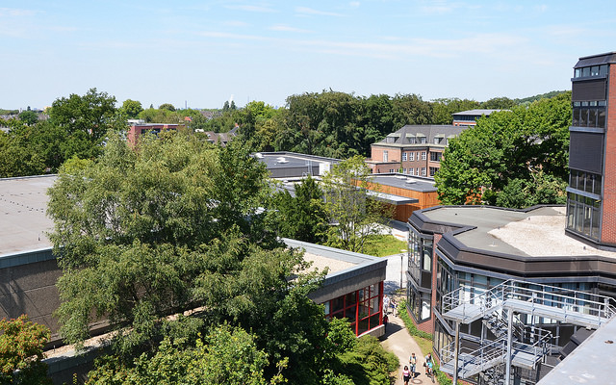
Global and Transnational Studies
What is Global and Transnational Sociology?
What are our main areas of research?
Notes:
At the upper division levels, graduate and post-doctoral programs focus on the world risk society and global cooperation.

Slide 6
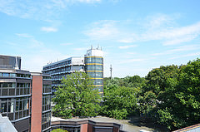
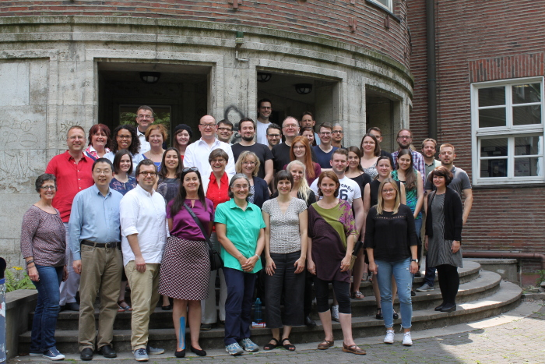
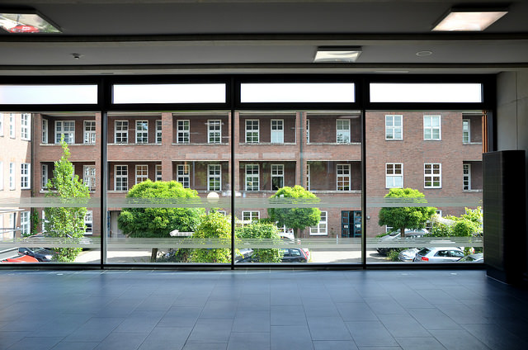
Institute of Sociology and UDE
The Institute of Sociology at UDE:
About us
Our major research areas
The point of the Summer School: Internationalization!
Notes:
number of scholars engaged in studies of work and employment, social structural change, comparative and transnational sociology.
Institute of Work, Skills and Training
Institute of East Asian Studies in Duisburg.
strong research activities of the faculty in comparative, international and transnational sociology

Slide 7
City Life
Heart of the Ruhr industrial area and at the intersections of the Rhine and Ruhr rivers
Central site of the industrial heritage route in Western Germany
Thyssen factory
Multi-cultural
Great summer destination
Excursions part of Summer School program
Notes:
Transformed into a landscape park and cultural center the Thyssen factory in the north of Duisburg is one of the city’s highlights.
The summer school also draws on the cultural diversity of the region, with a migrant population in North-Rhine Westphalia of 10.5% and city quarters with large ethnic populations and businesses.
Excursions are planned as part of the program in order to introduce international students to the industrial and multicultural history of the city and region.
The sun sets late at night, the city’s cafes are open past dark, and the lakes are only a short distance from the university.

Slide 8
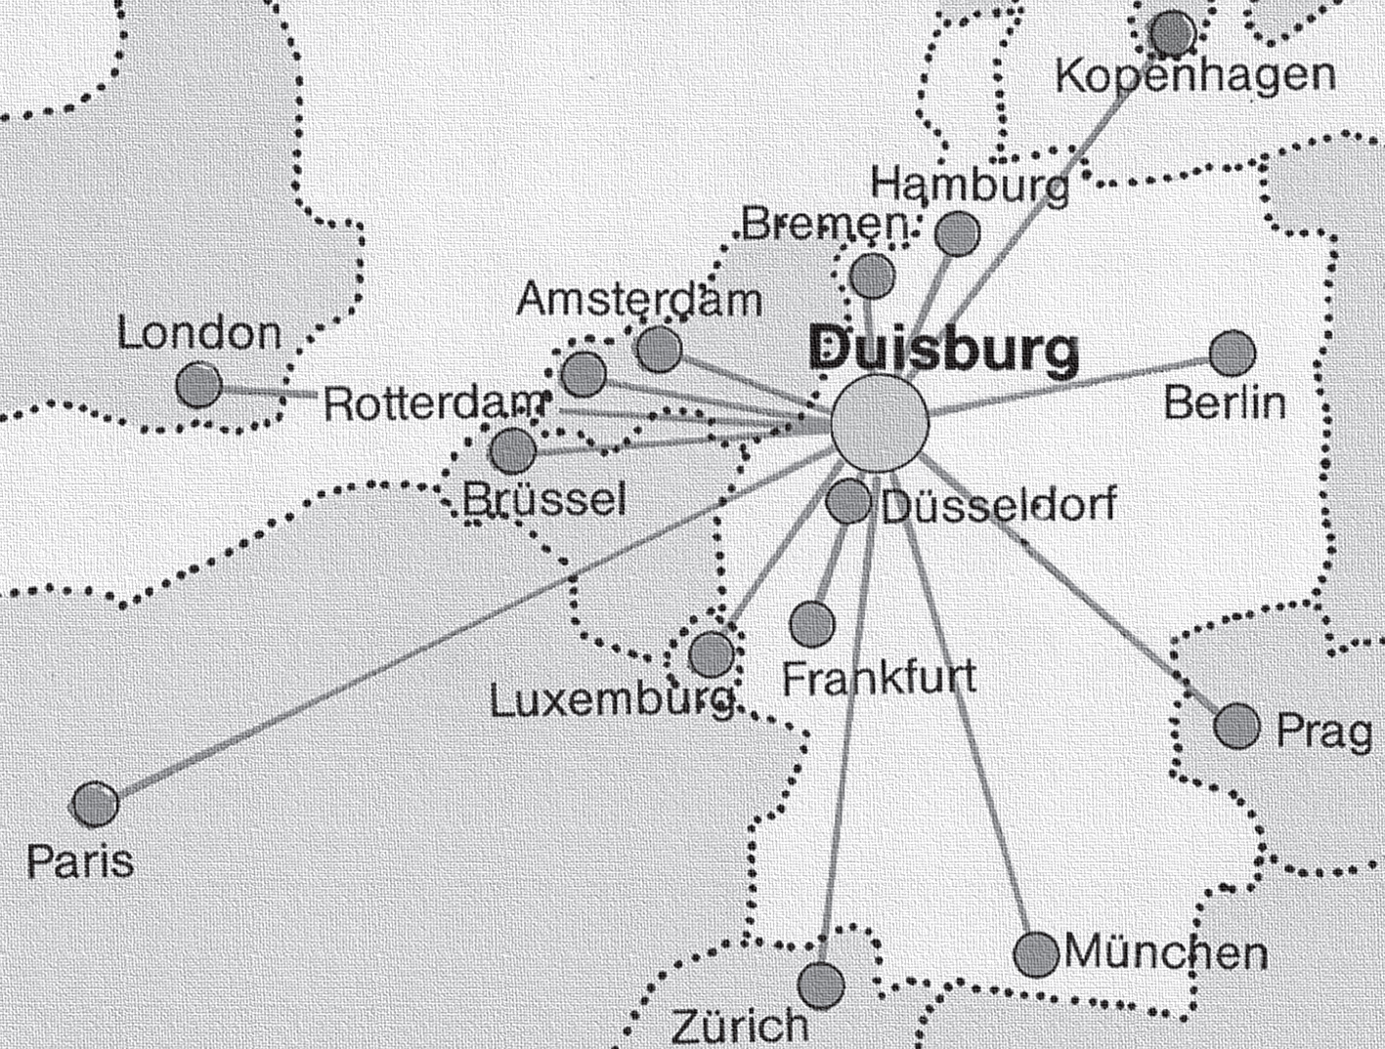
Duisburg and surroundings
The city itself, with a population of 500,000, is literally in the middle of the biggest population center in Europe, and everything is extremely well-connected! Want to explore west-central Europe? Look how close everything is!

Slide 9
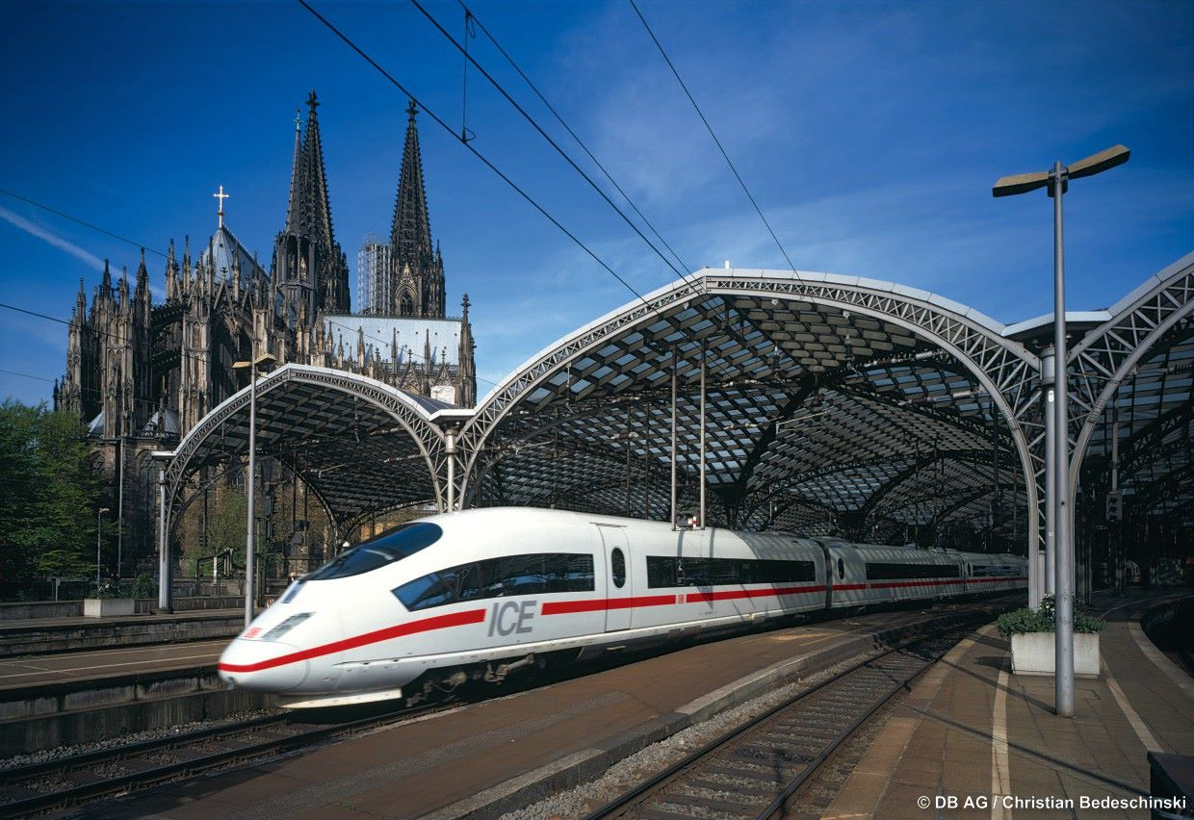
Connectivity
The following destinations can be reached via direct train from the Duisburg Station:
Essen: 10 minutes (free ride for students!)
Düsseldorf: 20 minutes (free ride for students!)
Dortmund: 35 minutes (free ride for students!)
Cologne: 45 minutes (free ride for students!)
Amsterdam: 2 hours
Brussels: 3 hours
Hamburg: 3.5 hours
Paris: 4 hours
Berlin: 4 hours
DUS, one of Germany’s busiest international aiports: 10 minutes (free ride for students!)

Slide 10
Global and Transnational Sociology Summer School June 13 – June 23, 2022, Part I
Social Medias and Global Societies
Prof. James Joseph Dean (Sonoma University)
Social inequality from national, transnational and global perspectives*
Prof. Jenny Preunkert (University of Duisburg-Essen) and Dr. Brian Conway (Maynooth University)
* PLEASE NOTE: This class is a blended learning seminar. Remote sessions will be in May and June 2022 (on three Thursdays, 10 am – 2 pm CET), in-class teaching will be in Duisburg from June 20 – June 24, 2022).

Slide 11
Global and Transnational Sociology Summer School June 27 – July 7, 2022, Part 2
Borders, Borderlands, Limits, Frontiers: Native Knowledge in Brazil and Latin America
Prof. Pedro Mandagará Ribeiro (Universidade de Brasília)
Contemporary Social Movements
Prof. Dario Azzellini (Cornell University)

Slide 12
Application and links
Application deadline: March 31, 2022
For more complete information about the courses on offer and the people who teach them, please visit our website: https://www.uni-due.de/soziologie /internationales_baplus.php

Slide 13
Interested in staying for a semester or longer?
You can also spend up to one year at the University of Duisburg-Essen
If you cannot speak any German, you will still be able to find enough classes taught in English to fill your schedule. If your German is decent, you can choose from over 3.000 courses.
Students at UDE are eligible to enroll at the following universities, further increasing the courses on offer:

Slide 14
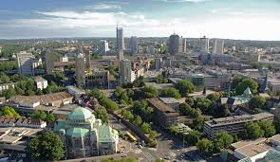
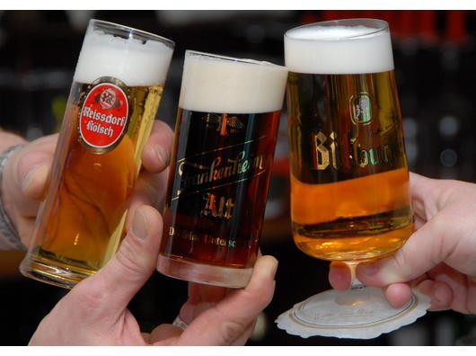
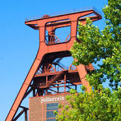
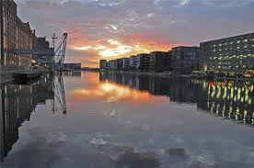
Student Life in Duisburg/Essen
Life in Duisburg = cool, cultural, cosmopolitan, cheap
Rent/Housing
Transportation
Cultural destinations (theatres, museums, cinemas, UNESCO World Heritage Site)
Other cultural destinations…
Notes:
German universities are heavily subsidized by the government, enabling students to live comfortably yet affordably. A private room in student housing, for example, costs between €180 and €230 month, and a warm meal at the cafeteria costs between €2.00 and €3.50.
What is more, transportation via train, bus, tram and subway within the region is included in the semester fees (approx. € 300/semester).
Many museums and cinemas as well as some bars and restaurants offer student discounts.

Slide 15
Summer School Team
Phone: +49 203 379 1343
Email: soc-internat@uni-due.de

